Slide 1
AIT582 – INDIVIDUAL PROJECT AIRLINE DATASET ANALYSIS
RAHUL KULKARNI GNUMBER: G01129825

Slide 2
INTRODUCTION
I am a data scientist for airline A, and I have to analyze the customer database and check the for trends, factors and help in increasing the customer base for this Airline
I have to identify the factors that are helpful in understanding why some customers are flying with our airline, while others are canceling.
My data science team wants to identify the important factors and help the advertising team develop customer-demographic-specific packages to attract more customers.

Slide 3
Description of the Data, Data Acquisition and Data Conversion:
There are totally 6 attributes: FARE, GUESTS, SEATCLASS, SUCCESS, AGE and GENDER
Also there are totally 891 records of data for this dataset.
i. CUSTOMERID: unique id of a customer 1. Unique Numeric-String
ii. SUCCESS: if the customer successfully flew on the booked trip 1. Binary {0,1}
iii. DESCRIPTION: description of the customer including name and age 1. String
iv. SEATCLASS: seat class chosen -- {1,2,3} 1. Categorical {1,2,3}
v. GUESTS: number of guests accompanying the main customer 1. Numeric
vi. FARE: total fare paid

Slide 4
Data Acquisition and Conversion:
The dataset file ait582-proj-data.json. It is a json format file, and in a semi-structured data format.
I had to convert it into a Comma-separated (CSV) file for easier data manipulation and interpretation.
I have used mainly python programming to which python packages such as pandas.
Here the first step is to read the json file with the pd.read_json and also converting this file into csv file.

Slide 5
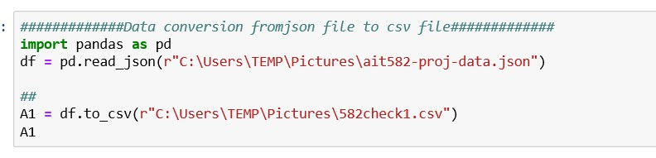
DATA CONVERSION (PYTHON)

Slide 6
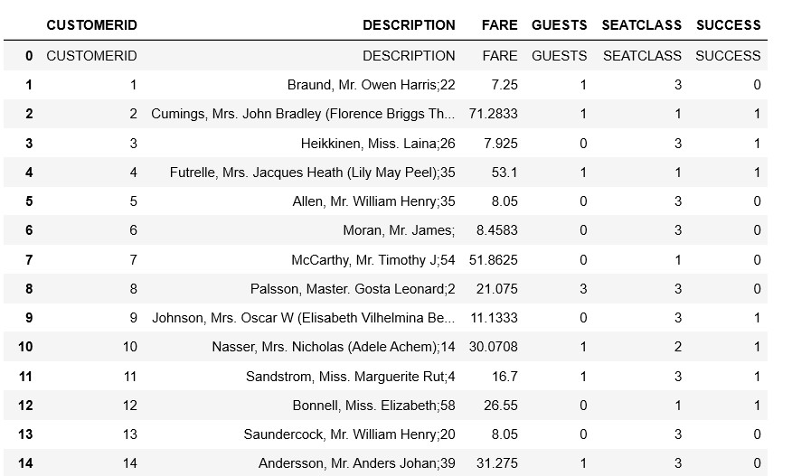
AIRLINE DATASET WITH ALL PARAMETERS

Slide 7
Metadata Extraction and Imputation:
We mainly extract metadata from the field “DESCRIPTION” and also this metadata type is ‘Descriptive metadata’.
From the “DESCRIPTIVE” field we can extract the AGE and GENDER fields.
So for the dataset available, after we extract the metadata information, we append the fields of AGE, GENDER and TITLE.
Also the field AGE has many number of missing values or data.
So the best technique which can be used her to impute the missing values is “median imputation”.
Here the missing values are imputated by taking the median of the AGE field.

Slide 8
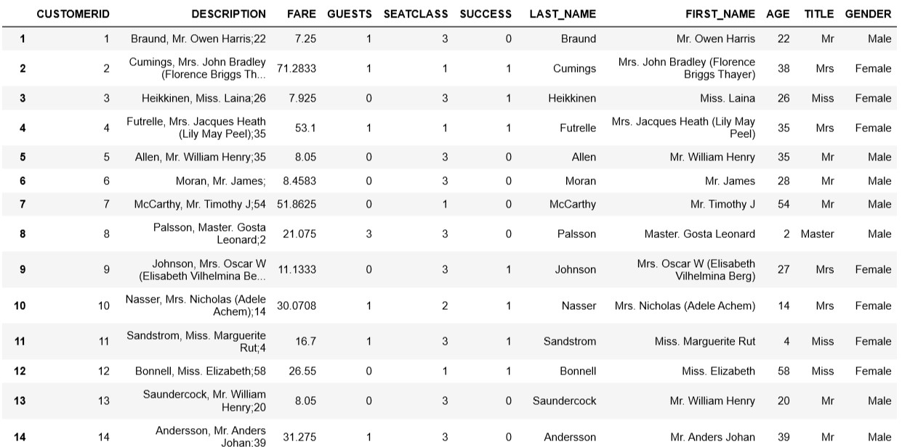
DATASET AFTER IMPUTATION

Slide 9
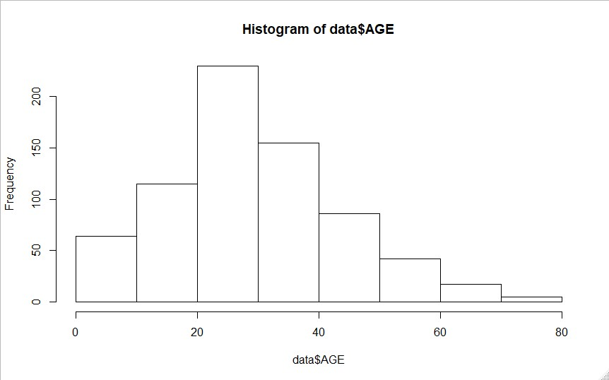
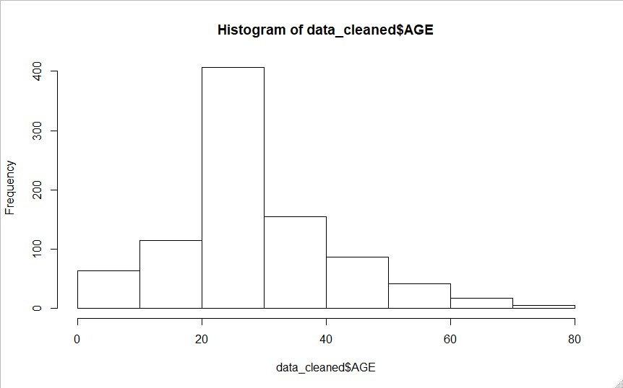
FIGURE 1:
FIGURE 2:
From Figure1 , (above) we have taken histogram of AGE factor from this dataset. Also dataset is not cleaned, which refers that the AGE column here has missing values.
This dataset for the Figure2 is a cleaned dataset and median imputation is performed on the AGE column.
So when we compare the Figure1 with Figure2, there is a reduction in the skewness of the data.

Slide 10
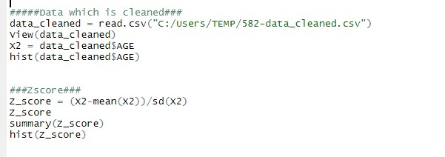
Z-score Normalization:
We can also perform normalization of the dataset to reduce the skewness in the data. We are performing it on the AGE column. One of the techniques used is the Zscore transformation.

Slide 11
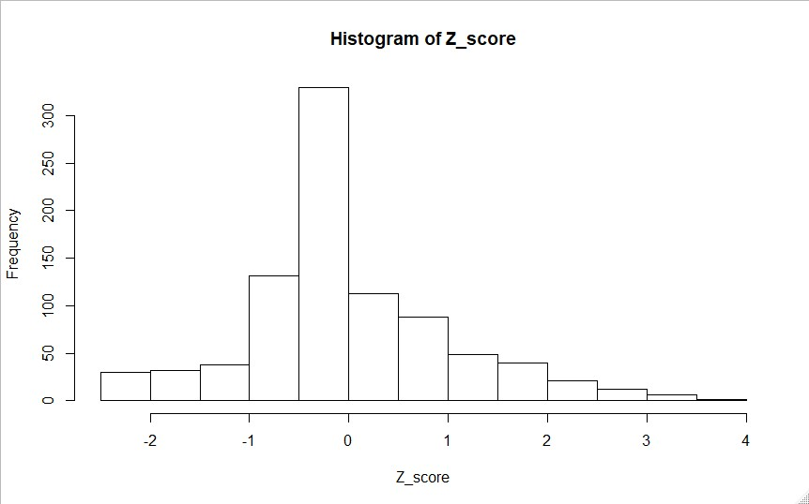

HISTOGRAM OF Z-SCORE
Skewness = 3(mean – median)/Standard deviation
= 3(0 – (-0.1046))/( 13.0197)
= 3 (0 + 0.1046)/(13.0197)
= 0.024
Here from the histogram we can conclude that it is left skewed with a value of 0.024

Slide 12
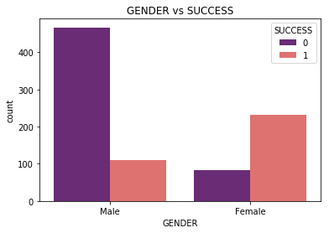
MetaData Exploration: GENDER VS SUCESS
SUCCESS 1 : customer successfully flew on the booked trip 1
SUCCESS 0: The customer booked the ticket, but didn’t fly with this Airline
we can analyze that more number of Female customers successfully flew on the booked trip 1 on this Airline when compared to male customers.
We can also analyze that more number of male customers booked this Airline compared to female customers, but didn’t fly with them.

Slide 13
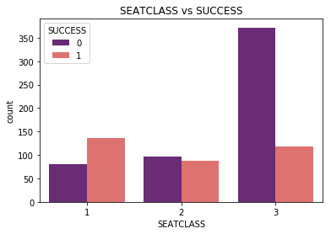
MetaData Exploration: SEATCLASS VS COUNT
SEATCLASS: seat class chosen -- {1,2,3}
SEATCLASS: This shows that the customers who have chosen the SeatClass 1, 2 and 3 respectively.
The customers who chose the SeatClass 1 have the highest success rate.
This refers that the customers who chose SeatClass 1 is where the maximum number of customers flew on booked trip 1 when compared to the customers who chose SeatClass 2 and 3.
we can analyze that the highest Seat bookings was done for SeatClass 3, but also maximum customers who had booked tickets on Seatclass 3 didn’t fly with this Airline.

Slide 14
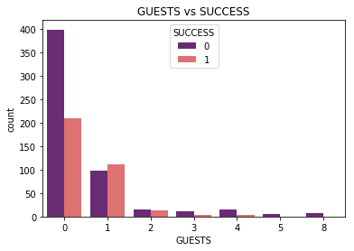
MetaData Exploration: GUESTS VS COUNT
Guests 0 : this refers no guest with the customer, the customer is travelling alone on this Airline
GUESTS 1: The customer is travelling with one guest on this airline
GUESTS 2: The customer is travelling with two guests on this airline
We can analyze that the count of customers who are travelling alone is more compared to the count of customers who are travelling with guests.

Slide 15
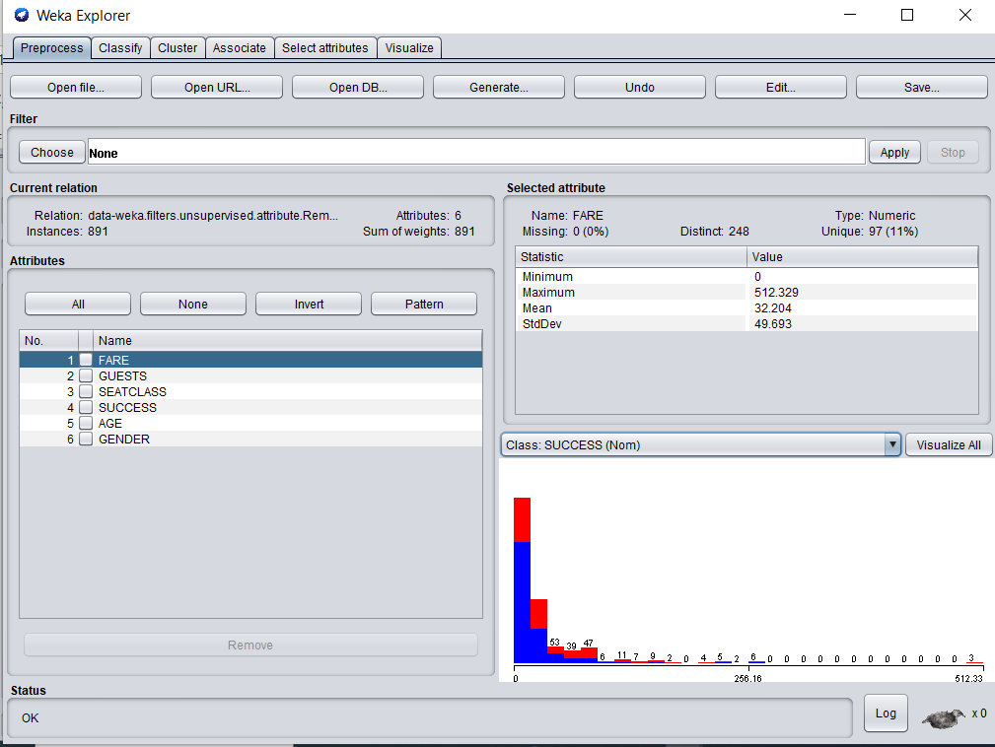
Milestone 4: Attribute Preparation and Engineering
Here, we are choosing the attributes from this dataset mainly which are useful data visualizations and building predictive models.
The attributes which I have chosen are FARE, GUESTS, SEATCLASS, SUCCESS, AGE and GENDER.
Also the attributes which I have removed and not using in Weka software are CUSTOMERID, DESCRIPTION, LAST_NAME, FIRST_NAME and TITLE.

Slide 16
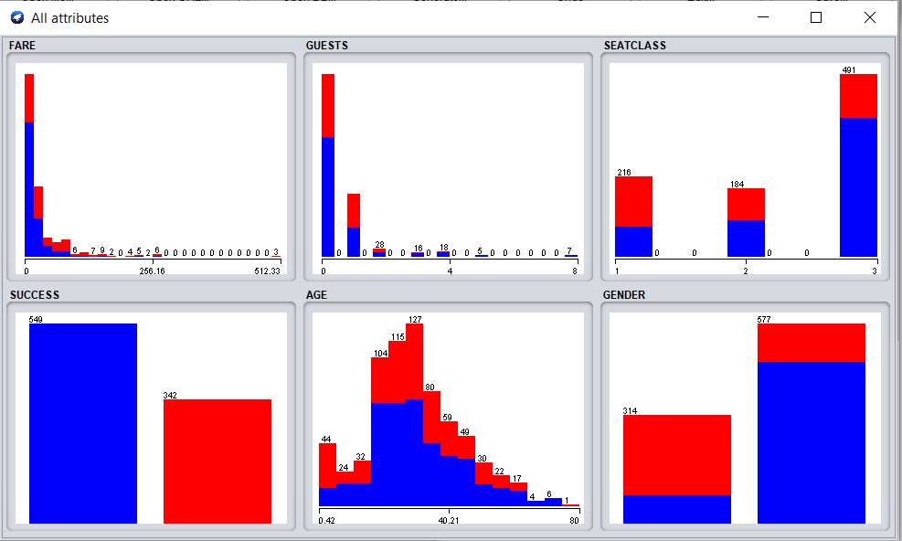
DATA VISUALIZATION
I have performed the data visualizations for all the selected attributes from the dataset.
I have also converted the SUCCESS attribute from ‘numerical and nominal’ form. So for the SUCCESS attribute, ‘1 = YES’ and ‘0 = NO’ has been assigned.
This will help us in building the predictive models in Weka software. SUCCESS attribute is the target attribute against which all other attributes are measured.
From this figure , we can see that the SUCCESS attribute 549 attributes is successful and 342 attributes are not successful.

Slide 17
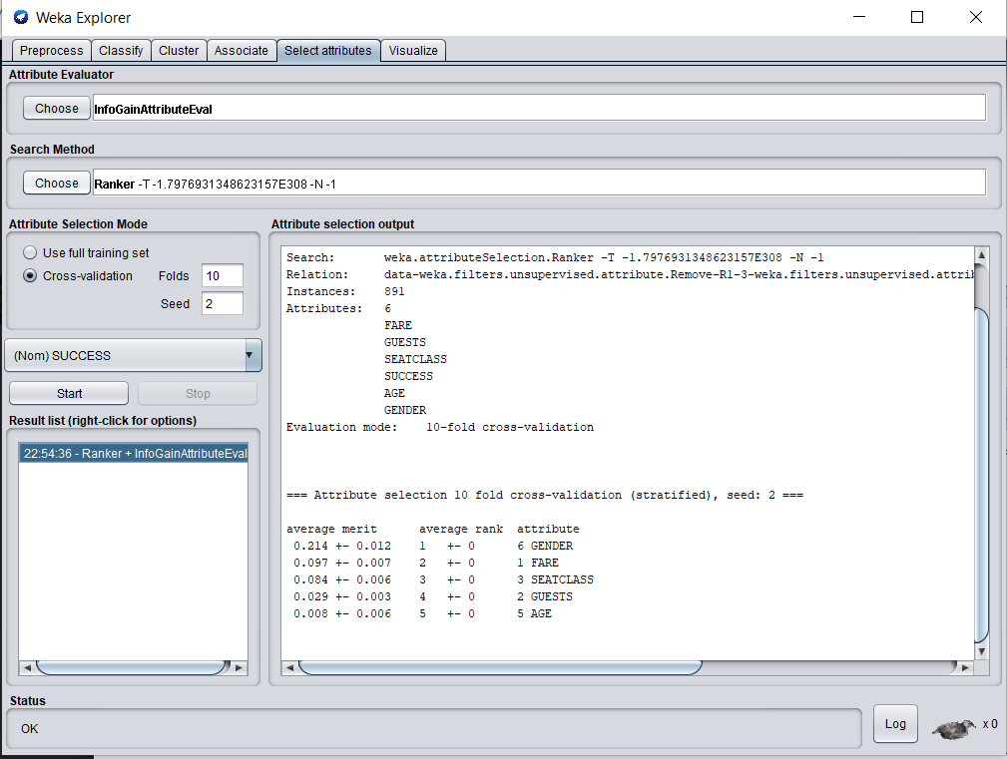
INFOGAIN ATTRIBUTE EVALUATOR
We have chosen the Info Gain Attribute Evaluator and the search method as ranker.
I have also chosen the cross validation where K = 10 folds and seed = 2. I have mainly performed this attribute evaluator to choose the top two attributes for this dataset.
Based on the analysis above, we can conclude that GENDER and FARE are the top two attributes for this dataset.

Slide 18
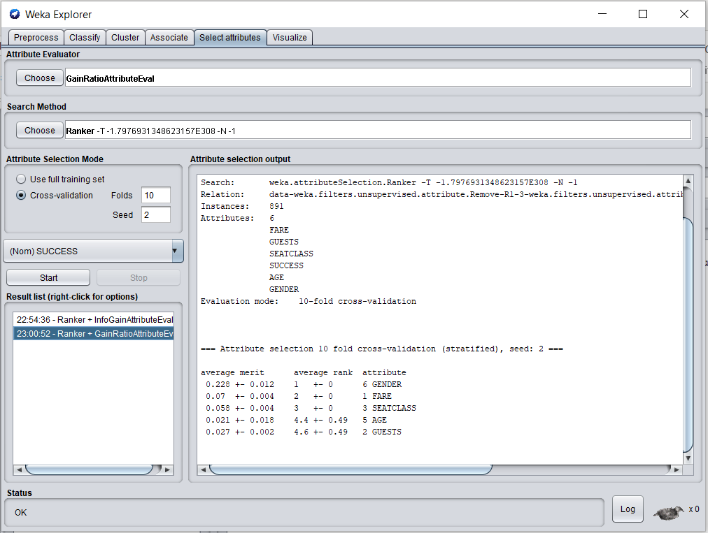
GAIN RATIO ATTRIBUTE EVALUATIOR
We have chosen the Gain Ratio Attribute Evaluator and the search method as ranker.
I have also chosen the cross validation where K = 10 folds and seed = 2.
I have mainly performed this attribute evaluator to choose the top two attributes for this dataset.
Based on the analysis above, we can conclude that GENDER and FARE are the top two attributes for this dataset.

Slide 19
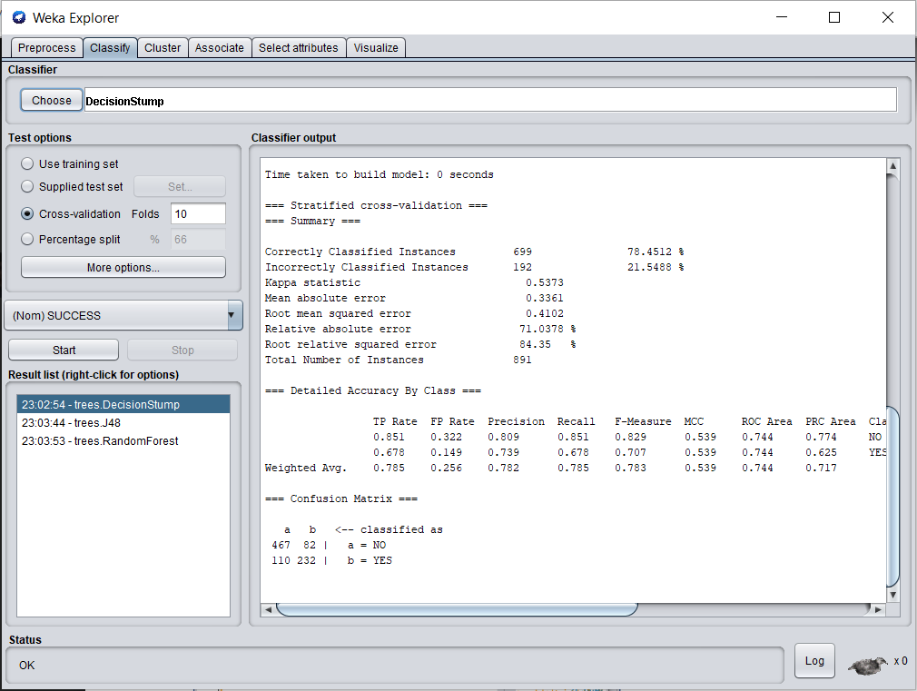
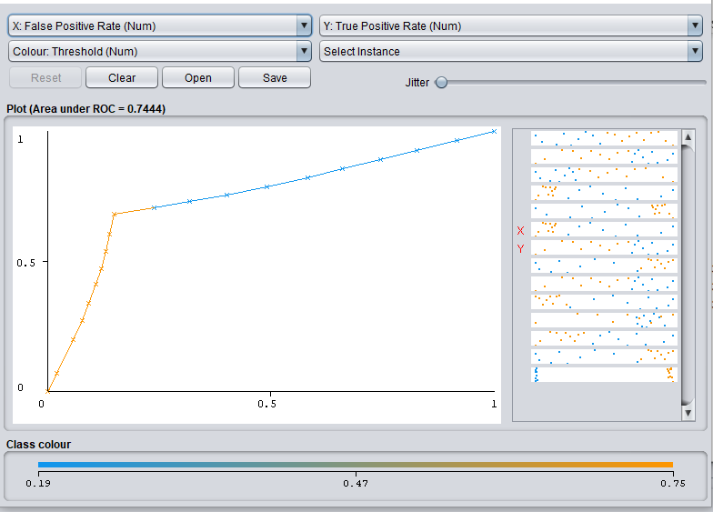
PREDICTIVE MODELING: DECISION STUMP
The analysis of the Decision Stump model. This is mainly a machine learning model which mainly takes a one input feature to perform the analysis.
For the Weka software, the classifier chosen as Decision Stump.
The cross validation is set for K = 10 folds.
Accuracy = 78.45%
Precision = 78.2%
Area under the ROC curve = 74.44%

Slide 20
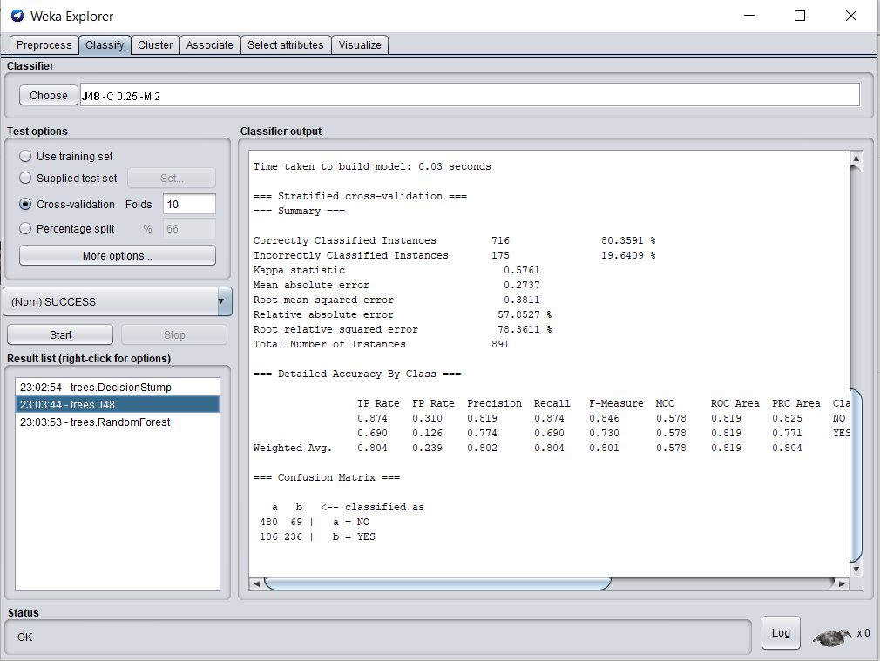
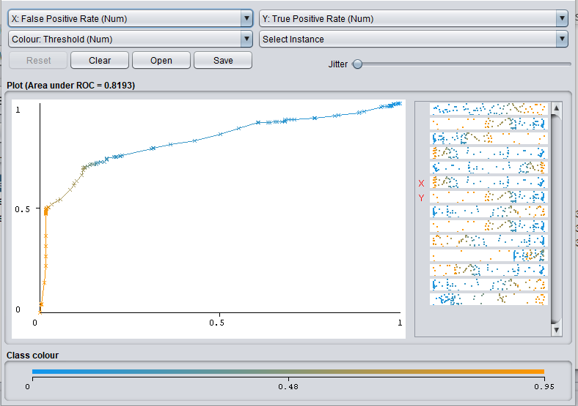
PREDICTIVE MODELING: J48 MODEL
The analysis of the J48 model. This is mainly a machine learning model which is a ID3 algorithm which mainly takes some of the best attributes to perform the analysis.
For the Weka software, the classifier chosen as Decision Stump. The cross validation is set for K = 10 folds.
Accuracy = 80.35%
Precision = 80.2%
Area under the ROC curve = 81.9%

Slide 21
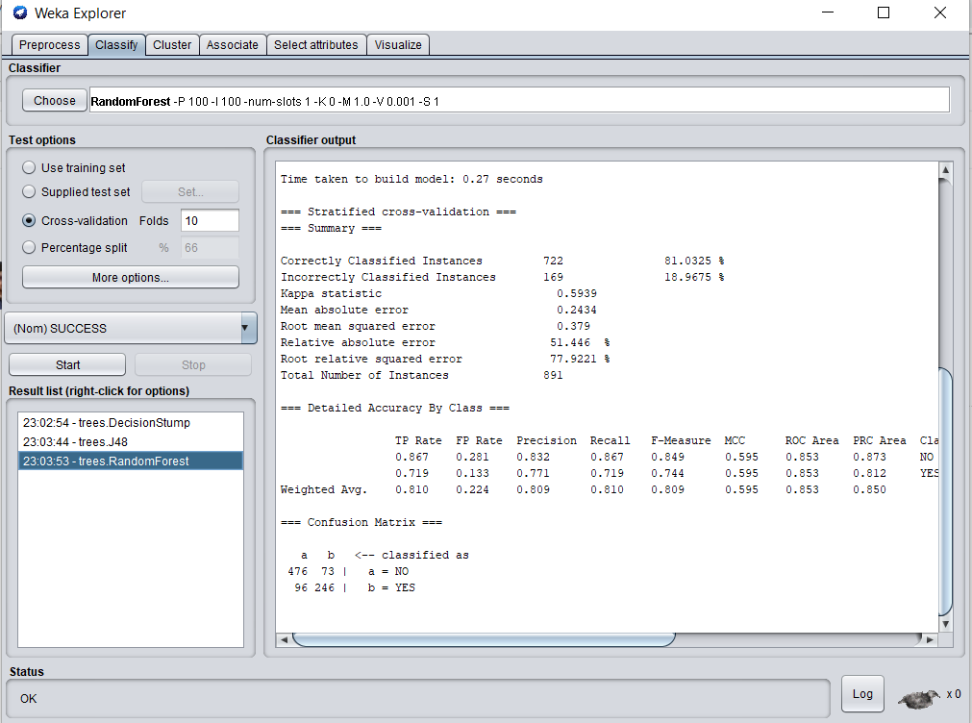
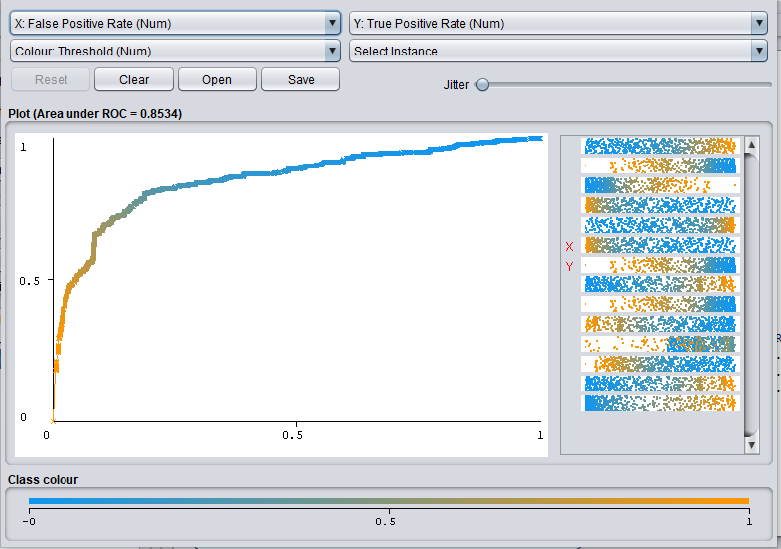
PREDICTIVE MODELING: RANDOM FOREST MODEL
The analysis of the Random Forest model. This model uses decision trees to perform analysis.
This Random forest model mainly uses many number of decision trees and also uses many bootstrap processes to perform the analysis.
For the Weka software, the classifier chosen is Random Forest model. The cross validation is set for K = 10 folds.
Accuracy = 81.03%
Precision = 80.9%
Area under the ROC curve = 85.34%

Slide 22
CONCLUSION:
We have performed totally predictive models which are Decision Stump, J48 and Random Forest model.
Random Forest model has best accuracy value among these three predictive models. Random Forest model has a accuracy of 81.03%, Precision of 80.9% and Area under the ROC curve is 85.34%.
For this dataset, we performed the Info Gain Attribute Evaluator and the Gain Ratio Attribute Evaluator. For both these Evaluators the top two attributes are GENDER and FARE.
So the two best predictors are GENDER and FARE for this dataset.
So the best technique which can be used her to impute the missing values is “median imputation”. Here the missing values are imputated by taking the median of the AGE field.
We can analyze that more number of Female customers successfully flew on the booked trip 1 on this Airline when compared to male customers. We can also analyze that more number of male customers booked this Airline compared to female customers, but didn’t fly with them.
We can analyze that the highest Seat bookings was done for SeatClass 3, but also maximum customers who had booked tickets on Seatclass 3 didn’t fly with this Airline. We can also analyze that when we compare SeatClass 2 and 3, many number of Customers didn’t fly with this Airline when compared to number of Customers who flew this Airline IN SeatClass 1.
We can analyze that the count of customers who are travelling alone is more compared to the count of customers who are travelling with guests. We can also analyze that the count of customers alone (Guest 0) who booked the ticket but didn’t fly with this airline is more compared to the count of the customers who had guests and didn’t fly with this airline. This also refers that the success rate is high for customers who are travelling alone compared to the customers who are travelling with guests.

